Slide 1
Enhancing Student Learning Through Metacognition
Enhancing Student Learning through Metacognition
Elizabeth Dickens
Assistant Director and
Assistant Professor
Adriana Streifer
Assistant Director and Assistant Professor

Slide 2
Workshop Goals
Workshop Goals
Understand the value of metacognition in aiding learning
Translate the principles of metacognition to your own context
Begin to develop an activity, assignment, and/or lesson to help students develop metacognitive skills

Slide 3
Word activity – first part
Without writing anything down, endeavor to learn these words in order. At the conclusion of the study period, you will be asked to write them down from memory.
SHE WAS FUN BUT SAD AND HID HER RED TOY BOX

Slide 4
Blank slide 1

Slide 5
Word activity – second part
Without writing anything down, endeavor to learn these words in order. At the conclusion of the study period, you will be asked to write them down from memory.
PAT SIN BOY DEN HUG WAS CAT WRY ODD MAD ICY

Slide 6
Blank slide 2

Slide 7
Word activity – third part
Without writing anything down, endeavor to learn these words in order. At the conclusion of the study period, you will be asked to write them down from memory.
BAP ERK MIR SEG POL GUA NUC ROM LAR ZAX FRU

Slide 8
Blank slide 3

Slide 9
Prompt: How do students learn?
How do your students learn the material in your course? How do they study? Do they study effectively? What strategies best support their learning?

Slide 10
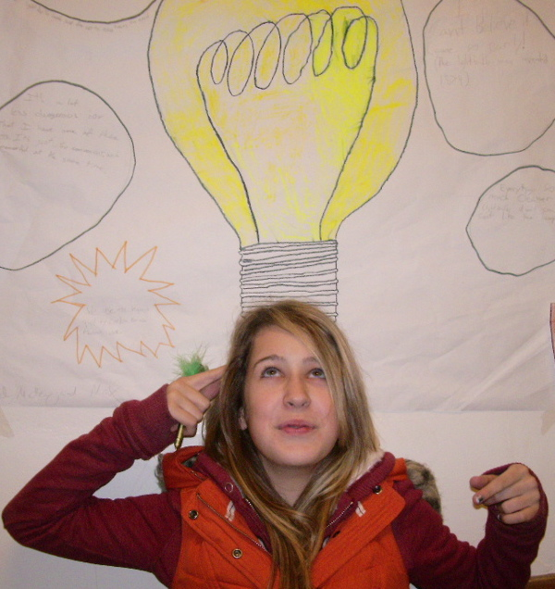
Metacognition definition
Metacognition
The ability to:
Think about one’s own thinking;
Be consciously aware of oneself as a problem solver;
Monitor, plan, and control one’s mental processing; and
Accurately judge one’s level of learning

Slide 11
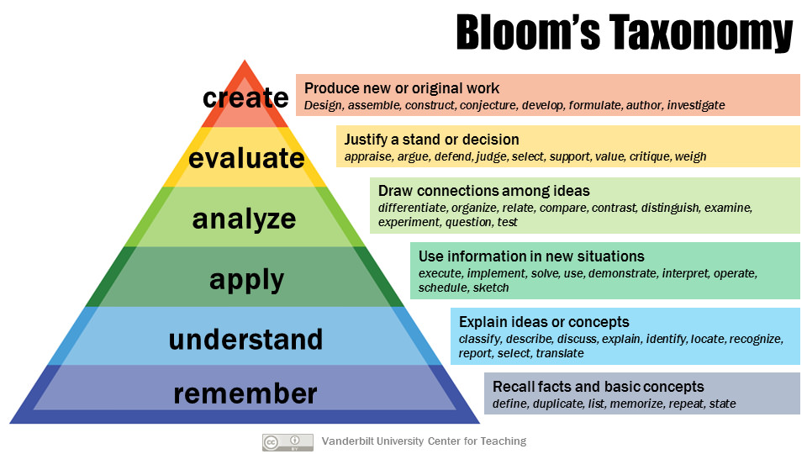
Bloom’s Taxonomy
O
Notes:
Our job as instructors may not be to turn all students into experts in our field. However, any course aims to move students further along the spectrum from novice to expert.
In order to see that movement occur, it is our job to give students opportunities to use higher-level thinking.
We need to establish, (or reinforce, depending on the level of the course) the foundational knowledge, while encouraging and challenging students to aim for the upper levels of the pyramid.
We also have to be transparent about the kinds of thinking our courses require – students often don’t realize that their old study habits will no longer serve them well, or they’ve never been prompted to think about how they learn.

Slide 12
Some caveats
Helping students become more metacognitively aware can pay huge dividends in their learning success, assuming:
Assessments are designed so that students need to rely on higher-level learning.
Students believe that learning is a skill that can be learned, and with practice they will improve.

Slide 13
Blank slide 4

Slide 14
Passive study Behaviors
Passive Study Behaviors
I came to class
I reviewed my notes
I made index cards
I re-read/highlighted the text
I asked a classmate or tutor to explain a concept to me
I looked up information
Aaron Jacobs 2005
Notes:
Give students a checklist and ask them to identify which practices they engage in most frequently. Ask them to select a few that they will try when studying in the future

Slide 15
Active Study Behaviors
Active Study Behaviors
I wrote my own study questions (and answered them)
I tried to figure out the answer before looking it up
I closed my notes and tested how much I remembered
I broke down complex processes step by step
I asked myself “How does it work?” or “Why does it work that way?”
I pretended I was teaching the material to someone else
Steven S. 2006

Slide 16
Exam Wrapper
Chemistry Self-Assessment and Reflection: Exam 1
This form will help you analyze your exam performance and find strategies that work best for you in learning the material for this course. Self-assessing and adjusting your study strategies accordingly is what effective learners tend to do. Please answer the questions sincerely. Your responses will have no impact on your grade. We will return your completed form before the next exam so that you can use your own responses to guide your studying next time.
Approximately how much time did you spend preparing for this exam?
What percentage of your preparation time was spent in each of these activities?
Skimming textbook chapters
Reading textbook chapters thoroughly
Reviewing your own notes
Working on practice problems
Other (please specify)
3. As you look at your graded exam, analyze where/how you lost points. Fill in the blank with the number of points you lost for each reason
Trouble applying definitions
Trouble remembering structures
Not understanding a concept
Careless mistake
Other (please specify)
4. Based on your responses above, name 3 things you plan to do differently when preparing for the next exam.

Slide 17
Reflective Writing
Writing 150
Revision Assignment
In this assignment, you will select one of your earlier papers and revise it. Revising a paper will give you the opportunity to reflect on your skills and to demonstrate the development of your skills over the course of the semester.
As you revise, add marginal commentary to your paper that details why you made changes you made.
Consider the following questions as you revise and write your commentary:
What advice did you get from your peers? From me? From other readers?
Which advice did you decide to take, and which did you ignore? Why?
Imagine that you had unlimited time to perfect this paper. What else would you do to make this paper even better, and why?
What new ideas about writing or writing practices will you use in future courses?

Slide 18
Activity Instructions
Build Metacognitive Components into your Course Design
Select a component of a course you teach (exam, paper, group project, in-class activity, homework, etc.)
What skills do students need in order to successfully complete this course component?
What will student need to know about their own learning so far in the course in order to complete this assignment?
What can you do to raise student’ self-awareness about the skills, levels of thinking, or processes needed to succeed at this component? Add something to your chosen course component that requires students to think meta-cognitively. (10-15 minutes)
Notes:
Criteria to consider when selecting part of your course:
In the past, what have been your student’s most common challenges? [Are any of these challenges in part caused by poor preparation or study habits?]
Where have you noticed gaps between students’ expectations of success and their actual performance?
Are there any particular components of the course that require students to employ (to them) brand new skills or advanced forms of thought (higher up the pyramid on Bloom’s Taxonomy)?
What components of your course rely (implicitly or explicitly) on self-reflection or self-evaluation in order for students to succeed? (ex: revisions of papers; re-doing problems on a test; submitting an outline, plan, or proposal as part of a project; determining roles in group projects; etc.)
Debrief Questions:
What is your activity/exercise/additional questions?
Why did you design this particular thing?
What are you hoping students get out of it?

